Slide 1

Roomify
Automated intelligent meeting room bookings
09.03.24

Slide 2

Agenda
INTRODUCTION
RESULTS FROM LAST YEAR
TEAM
WHAT’S NEXT
CLOSING

Slide 3
Title & content
Profits are up, and losses are down! We are very proud of the progress our team has made. Today we’ll review our wins and losses from last year and give you an overview of what you can expect for next year.
Profits are up, and losses are down! We are very proud of the progress our team has made. Today we’ll review our wins and losses from last year and give you an overview of what you can expect for next year.
Profits are up, and losses are down! We are very proud of the progress our team has made. Today we’ll review our wins and losses from last year and give you an overview of what you can expect for next year.

Slide 4

Title & content
Profits are up, and losses are down! We are very proud of the progress our team has made. Today we’ll review our wins and losses from last year and give you an overview of what you can expect for next year.
Profits are up, and losses are down! We are very proud of the progress our team has made. Today we’ll review our wins and losses from last year and give you an overview of what you can expect for next year.
Profits are up, and losses are down! We are very proud of the progress our team has made. Today we’ll review our wins and losses from last year and give you an overview of what you can expect for next year.

Slide 5

INTRODUCTION
HOW WE DID LAST YEAR
Profits are up, and losses are down! We are very proud of the progress our team has made.
Today we’ll review our wins and losses from last year and give you an overview of what you can expect for next year.

Slide 6

Company overview
Let’s Dive In

Slide 7
Growth by sector

Slide 8
Growth by sector table
 | Q1 | Q2 | Q3 | Q4
SERIES 1 | 4.3 | 2.5 | 3.5 | 4.5
SERIES 2 | 2.4 | 4.4 | 1.8 | 2.8
SERIES 3 | 2 | 2 | 3 | 5

Slide 9
A SATISFIED CUTOMER
“FABRIKAM WAS GREAT TO WORK WITH. LARISSA WAS MY REPRESENTATIVE AND SHE ANTICIPATED MY NEEDS AND WORKED DILIGENTLY TO FIX MY ISSUE.”

Slide 10



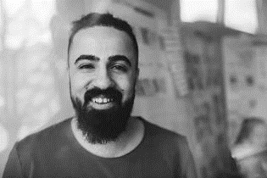


Meet the team
ana
larissa
ceo
cfo
Roman
Federico
CTO
CPO
ALEJANDRA
Jim
CMO
coo

Slide 11

What’s next
LOOKING AHEAD

Slide 12
quarterly timeline
Deploy strategic networks with compelling e-business needs
September 20XX
Synergize scalable e-commerce
November 20XX
Disseminate standardized metrics
January 20XX
Coordinate e-business applications
March 20XX
Foster holistically superior methodologies
May 20XX

Slide 13


Goals for Q2
EMPLOYEE OPPORTUNITIES
BUSINESS PRIORITIES
End of fiscal celebration on July 15th
Employee day of learning on August 14th
Employee yoga on September 3rd
Seminar series begins September 10th
Increase customer satisfaction by 2%
Maintain growth
Initiative partnership with 3rd party organizations

Slide 14



Goals for q3
BUSINESS PRIORITIES
Added PRIORITIES
EMPLOYEE OPPORTUNITIES
Increase customer satisfaction by 2%
Maintain growth
Improve social media presence
Ensure the cost of development stays below budget
Interns begin
Indoor rec leagues
Chess tournaments
Big Game watching party

Slide 15

Summary
OUR BUSINESS IS GOOD
Profits are up in the last quarter by 3%
WE’RE GETTING OUR WORK DONE
We finished the consolidation project
WE’RE DELIVERING FOR OUR CUSTOMERS
Customer satisfaction increased from 70 to 80%
OUR CUSTOMERS KEEP COMING BACK
We increased customer retention by 4%

Slide 16
B2B market scenarios
Iterative approaches to corporate strategy
Establish a management framework from the inside
Develop winning strategies to keep ahead of the competition
Capitalize on low hanging fruit to identify a ballpark value
Visualize customer directed convergence

Slide 17

Two content
Profits are up, and losses are down! We are very proud of the progress our team has made. Today we’ll review our wins and losses from last year and give you an overview of what you can expect for next year.
Profits are up, and losses are down! We are very proud of the progress our team has made. Today we’ll review our wins and losses from last year and give you an overview of what you can expect for next year.

Slide 18
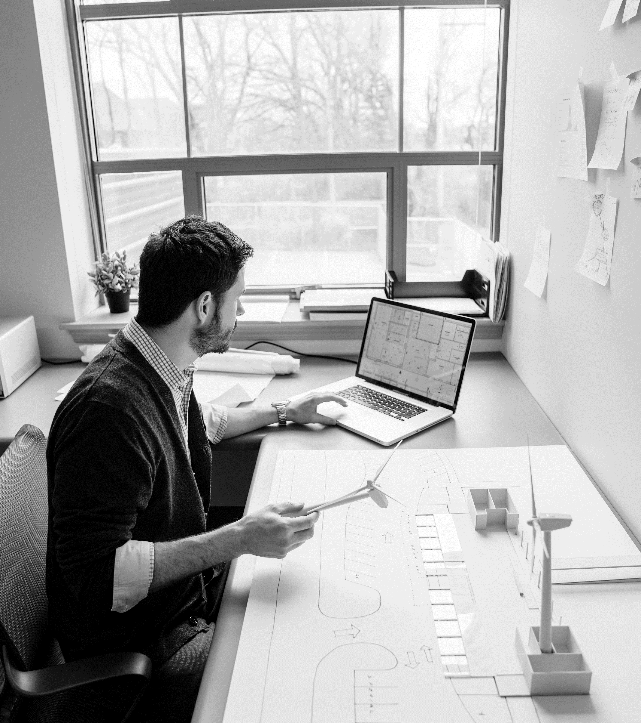
Two content
Profits are up, and losses are down! We are very proud of the progress our team has made. Today we’ll review our wins and losses from last year and give you an overview of what you can expect for next year.
Profits are up, and losses are down! We are very proud of the progress our team has made. Today we’ll review our wins and losses from last year and give you an overview of what you can expect for next year.

Slide 19




THANK YOU
VICTORIA LINDQVIST
+1 (589) 555-0199
victoria@fabrikam.com
WWW.FABRIKAM.COM

